Slide 1
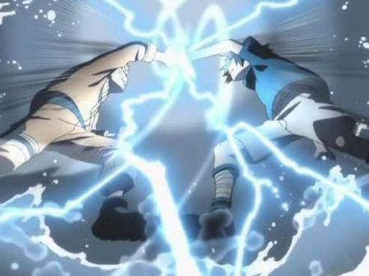
Adversarial Attack
Hung-yi Lee
Source of image: http://www.fafa01.com/post865806
Notes:
TBD: NLP Attack / One pic attack
================================
Adversarial Attack Reference:
Intriguing properties of neural networks https://arxiv.org/pdf/1312.6199 Explaining and Harnessing Adversarial Examples https://arxiv.org/abs/1412.6572 Towards Evaluating the Robustness of Neural Networks https://arxiv.org/pdf/1608.04644.pdf ADVERSARIAL REPROGRAMMING OF NEURAL NETWORKS https://arxiv.org/pdf/1810.00069.pdf Audio Adversarial Examples: Targeted Attacks on Speech-to-Text https://arxiv.org/pdf/1801.01944.pdf Towards Deep Learning Models Resistant to Adversarial Attacks https://arxiv.org/abs/1706.06083 Obfuscated Gradients Give a False Sense of Security: Circumventing Defenses to Adversarial Examples https://arxiv.org/pdf/1802.00420.pdf
One pixel attack for fooling deep neural networks
============
Slide :https://media.neurips.cc/Conferences/NIPS2018/Slides/adversarial_ml_slides_parts_1_4.pdf
Two hour tutorial: https://www.youtube.com/watch?v=TwP-gKBQyic (good one, with web page)
Good fellow
https://www.youtube.com/watch?v=CIfsB_EYsVI
More videos (I am not sure about the quality)
https://www.youtube.com/watch?v=r8cW1p8VBOU
https://www.youtube.com/watch?v=sh6OS6Lssv4
Tutorial which is too long: http://pralab.diee.unica.it/en/wild-patterns
科普
Video: https://www.youtube.com/watch?v=oZYgaD004Dw
Video: https://www.youtube.com/watch?v=SA4YEAWVpbk

Slide 2


Motivation
You have trained many neural networks.
We seek to deploy neural networks in the real world.
Are networks robust to the inputs that are built to fool them?
Useful for spam classification, malware detection, network intrusion detection, etc.
Aim to fool the network

Slide 3
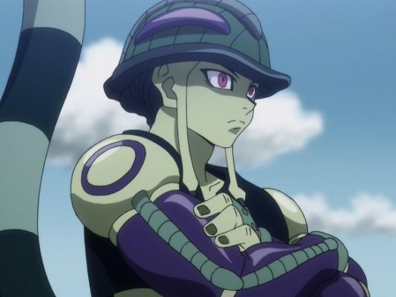
人類不講武德 …

Slide 4
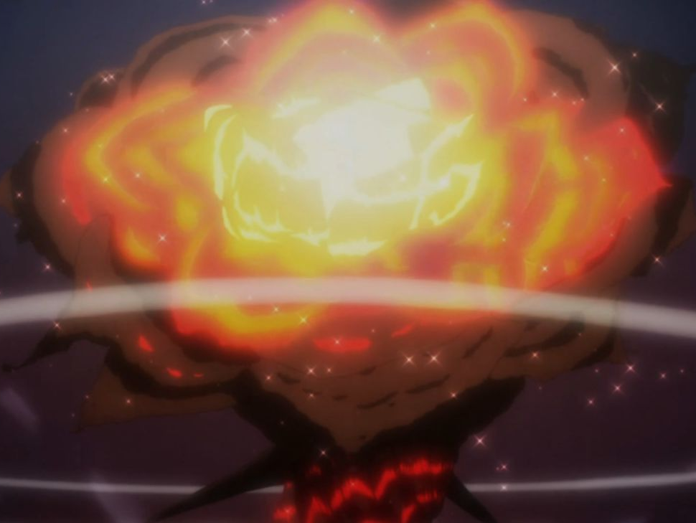
Notes:
不講武德

Slide 5
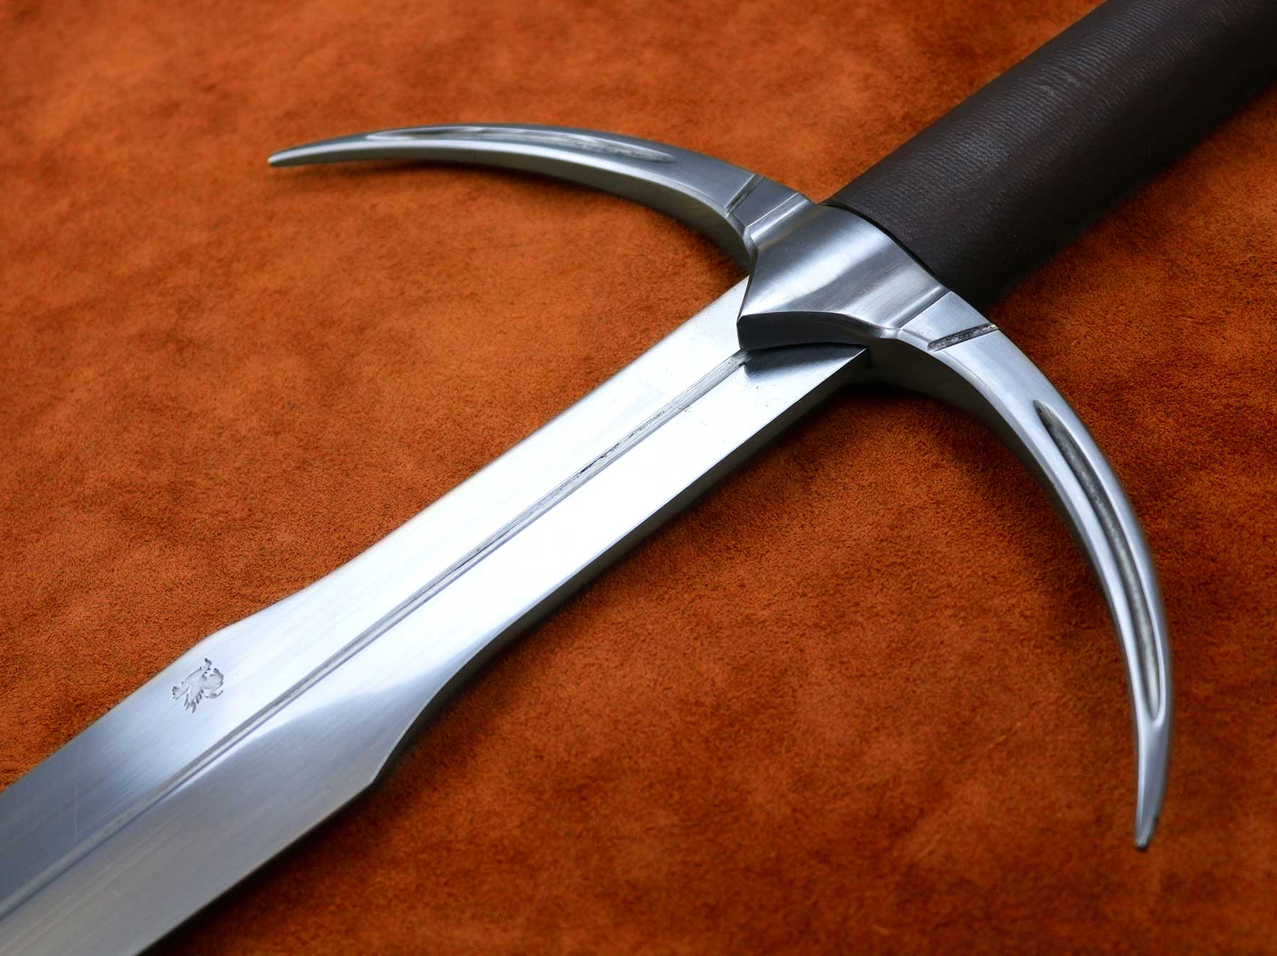
How to Attack
https://www.darksword-armory.com/wp-content/uploads/2014/09/two-handed-danish-sword-medieval-weapon-1352-3.jpg
Notes:
Slide :https://media.neurips.cc/Conferences/NIPS2018/Slides/adversarial_ml_slides_parts_1_4.pdf
Two hour tutorial: https://www.youtube.com/watch?v=TwP-gKBQyic (good one, with web page)
Good fellow
https://www.youtube.com/watch?v=CIfsB_EYsVI
More videos (I am not sure about the quality)
https://www.youtube.com/watch?v=r8cW1p8VBOU
https://www.youtube.com/watch?v=sh6OS6Lssv4
Tutorial which is too long: http://pralab.diee.unica.it/en/wild-patterns
科普
Video: https://www.youtube.com/watch?v=oZYgaD004Dw
Video: https://www.youtube.com/watch?v=SA4YEAWVpbk

Slide 6
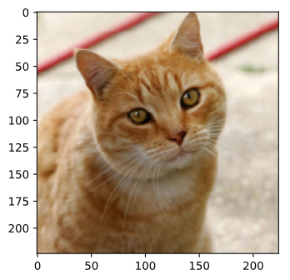
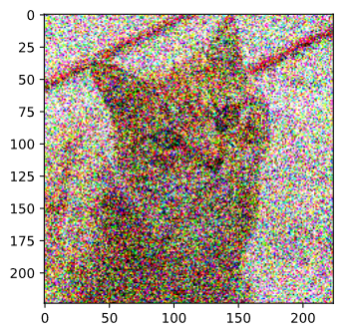
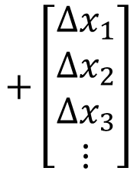
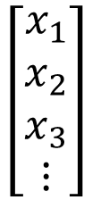
Example of Attack
Non-targeted
Anything other than “Cat”
Targeted
Misclassified as a specific class (e.g., “Star Fish”)
Benign Image
Network
(Image Classifier)
Something Else
Tiger Cat
$$\left[\begin{aligned}x_{1} \\ x_{2} \\ x_{3} \\ ⋮\end{aligned}\right]$$
$$+\left[\begin{aligned}{∆x}_{1} \\ {∆x}_{2} \\ ∆x_{3} \\ ⋮\end{aligned}\right]$$
Attacked Image
small

Slide 7

Example of Attack
Network
ResNet-50
=
The target is “Star Fish”
Benign Image
Attacked Image
Tiger Cat
Star Fish
0.64
1.00
Notes:
要先講 explainable AI

Slide 8
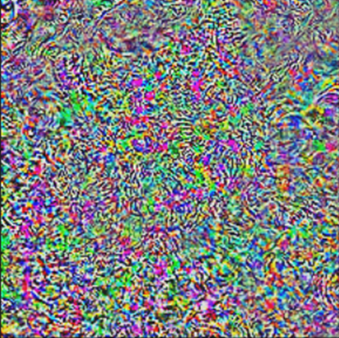
Example of Attack
=
Benign Image
Attacked Image
50x
-
Tiger Cat
Star Fish
0.64
1.00
Notes:
要先講 explainable AI

Slide 9

Example of Attack
Network
ResNet-50
=
The target is “Keyboard”
Benign Image
Attacked Image
Tiger Cat
Keyboard
0.64
0.98
Notes:
要先講 explainable AI

Slide 10

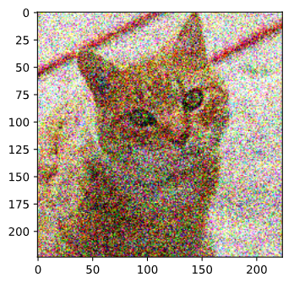
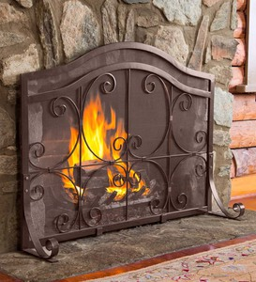
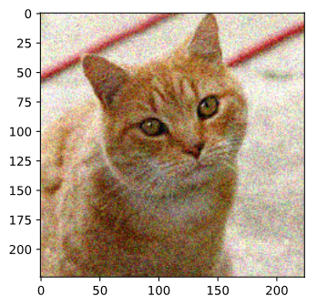
tiger
cat
Persian
cat
tabby
cat
fire
screen

Slide 11
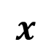
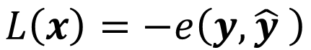
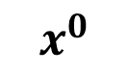
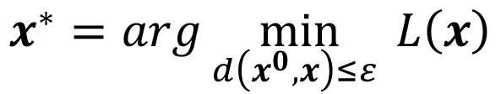
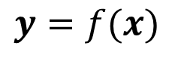
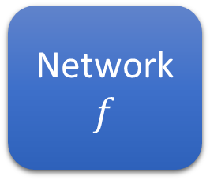
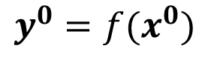
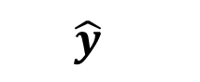
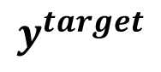
How to Attack
cat
cat
dog
fish
Network
$$f$$
$$x^{0}$$
$$y^{0}=f(x^{0})$$
$$\hat{y}$$
far
close
?
$$x$$
(parameters are fixed)
$$y^{target}$$
$$y=f(x)$$
close
e.g., fish
Non-targeted
$$x^{∗}=arg\min_{d\left(x^{0},x\right)≤ε }{L\left(x\right)}$$
not perceived by humans
$$L\left(x\right)=−e\left(y,\hat{y} \right)$$
Targeted
$$L\left(x\right)=−e\left(y,\hat{y} \right)+e\left(y,y^{target}\right)$$
Notes:
Depending on the task

Slide 12
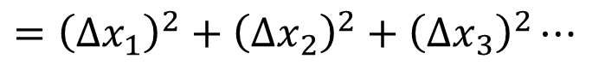
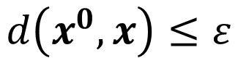
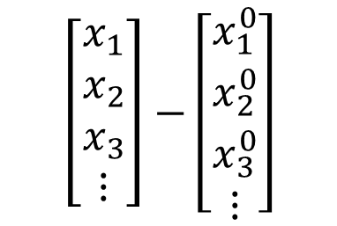
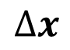
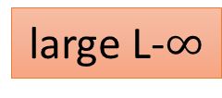
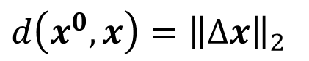
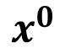
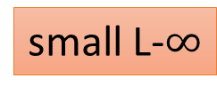
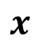
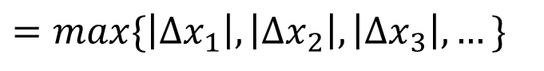
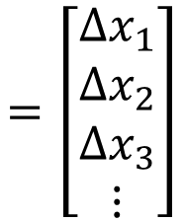
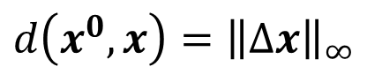
Non-perceivable
$$\left[\begin{aligned}x_{1} \\ x_{2} \\ x_{3} \\ ⋮\end{aligned}\right]−\left[\begin{aligned}x_{1}^{0} \\ x_{2}^{0} \\ x_{3}^{0} \\ ⋮\end{aligned}\right]$$
$$=\left[\begin{aligned}{∆x}_{1} \\ {∆x}_{2} \\ ∆x_{3} \\ ⋮\end{aligned}\right]$$
Need to consider human perception
$$d\left(x^{0},x\right)≤ε$$
$$x$$
$$x^{0}$$
$$∆x$$
L2-norm
L-infinity
small L-$∞$
Change every pixel a little bit
$$d\left(x^{0},x\right)={\left\|∆x\right\|}_{2}$$
$$={\left({∆x}_{1}\right)}^{2}+{\left({∆x}_{2}\right)}^{2}+{\left({∆x}_{3}\right)}^{2}⋯$$
same L2
$$d\left(x^{0},x\right)={\left\|∆x\right\|}_{∞}$$
Change one pixel much
$$=max\{\left|∆x_{1}\right|,\left|∆x_{2}\right|,\left|∆x_{3}\right|,…\}$$
large L-$∞$

Slide 13
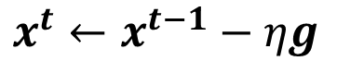
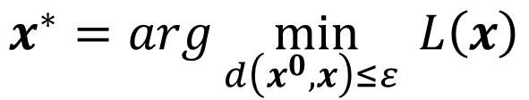
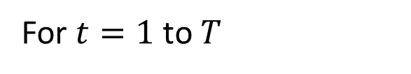
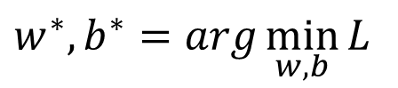
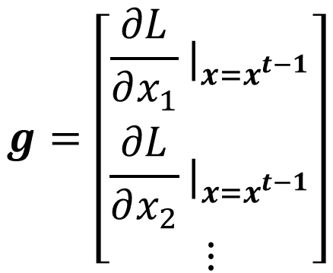
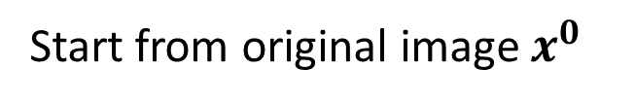
$$w^{∗},b^{∗}=arg\min_{w,b}{L}$$
Difference?
Attack Approach
Update input, not parameters
$$x^{∗}=arg\min_{d\left(x^{0},x\right)≤ε }{L\left(x\right)}$$
Gradient Descent
Start from original image $x^{0}$
$$g=\left[\begin{aligned}\frac{∂L}{∂x_{1}}|_{x=x^{t−1}} \\ \frac{∂L}{∂x_{2}}|_{x=x^{t−1}} \\ ⋮\end{aligned}\right]$$
For $t=1$ to $T$
$$x^{t}←x^{t−1}−ηg$$

Slide 14
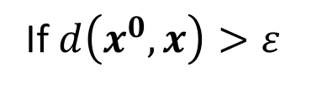
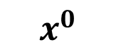
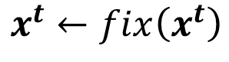
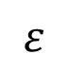
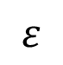
Attack Approach
$$w^{∗},b^{∗}=arg\min_{w,b}{L}$$
Difference?
Update input, not parameters
Different optimization methods
$$x^{∗}=arg\min_{d\left(x^{0},x\right)≤ε }{L\left(x\right)}$$
Different constraints
after update
Gradient Descent
L-infinity
Start from original image $x^{0}$
For $t=1$ to $T$
fixed
$$x^{t}←x^{t−1}−ηg$$
$$ε$$
$$x^{0}$$
If $d\left(x^{0},x\right)>ε$
$$x^{t}←fix\left(x^{t}\right)$$
$$ε$$

Slide 15
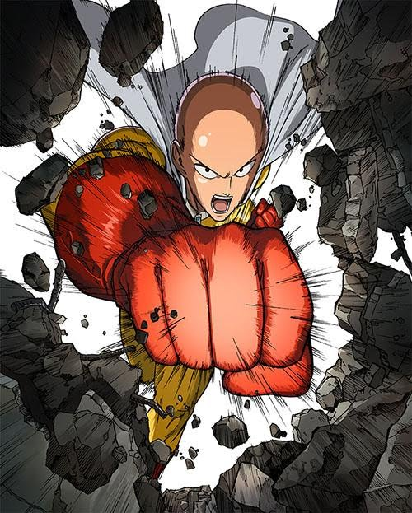
Attack Approach
$$x^{∗}=arg\min_{d\left(x^{0},x\right)≤ε }{L\left(x\right)}$$
Fast Gradient Sign Method (FGSM)
https://arxiv.org/abs/1412.6572
Start from original image $x^{0}$
For $t=1$ to $T$
$$x^{t}←x^{t−1}−ηg$$

Slide 16
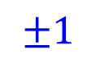
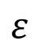

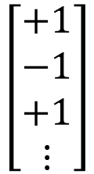
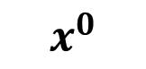
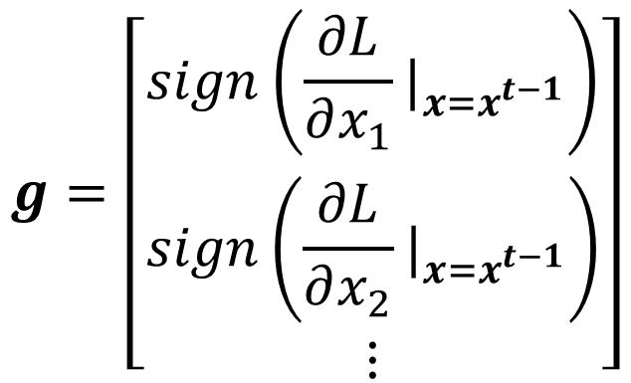


Attack Approach
L-infinity
$$ε$$
$$x^{0}$$
$$x^{∗}=arg\min_{d\left(x^{0},x\right)≤ε }{L\left(x\right)}$$
$$ε$$
Fast Gradient Sign Method (FGSM)
https://arxiv.org/abs/1412.6572
Start from original image $x^{0}$
$$g=\left[\begin{aligned}sign\left(\frac{∂L}{∂x_{1}}|_{x=x^{t−1}}\right) \\ sign\left(\frac{∂L}{∂x_{2}}|_{x=x^{t−1}}\right) \\ ⋮\end{aligned}\right]$$
For $t=1$ to $T$
$$±1$$
$$x^{t}←x^{t−1}−ηg$$
$$\left[\begin{aligned}+1 \\ −1 \\ +1 \\ ⋮\end{aligned}\right]$$
$$±1$$
$$ε$$
$$if t>0, sign\left(t\right)=1;otherwise,sign\left(t\right)=−1$$

Slide 17
after update
Attack Approach
L-infinity
fixed
$$ε$$
$$x^{0}$$
$$x^{∗}=arg\min_{d\left(x^{0},x\right)≤ε }{L\left(x\right)}$$
$$ε$$
Iterative FGSM
https://arxiv.org/abs/1607.02533
Start from original image $x^{0}$
$$g=\left[\begin{aligned}sign\left(\frac{∂L}{∂x_{1}}|_{x=x^{t−1}}\right) \\ sign\left(\frac{∂L}{∂x_{2}}|_{x=x^{t−1}}\right) \\ ⋮\end{aligned}\right]$$
For $t=1$ to $T$
$$±1$$
$$x^{t}←x^{t−1}−ηg$$
If $d\left(x^{0},x\right)>ε$
$$±1$$
$$x^{t}←fix\left(x^{t}\right)$$

Slide 18



White Box v.s. Black Box
$$g=\left[\begin{aligned}sign\left(\frac{∂L}{∂x_{1}}|_{x=x^{t−1}}\right) \\ sign\left(\frac{∂L}{∂x_{2}}|_{x=x^{t−1}}\right) \\ ⋮\end{aligned}\right]$$
In the previous attack, we know the network parameters $θ$
This is called White Box Attack.
You cannot obtain model parameters in most online API.
Are we safe if we do not release model? ☺
No, because Black Box Attack is possible. ☹
Notes:
Gray-box Attack?
SHIROBAKO（日語漢字寫作「白箱」，意思指中文的「白盒」）指作品播放前發送給所有工作人員的未剪接樣片，因為樣片是裝在白色的盒子裡（日文漢字為「箱」，實際上指中文的盒子），故有此稱呼
======
Papernot et al（2016） 發表的攻擊方式是目前最具威力的一種，針對影像辨識的深度學習服務，可以透過 API 取得一些分類結果後，另外在本地訓練一個 local model，對 local model 找出可用的對抗例，轉移（transfer）回去攻擊目標 API。論文裡對 Amazon 與 Google 的服務實測都有近 90% 的成功率。簡單地說，黑箱攻擊是可行的
最近 Chen et al（2017）[14]提出了「零階最佳化」（zeroth order optimization；ZOO）、Hayes and Danezis（2017）[15]提出 adversarial service，都是不用依靠移轉就可以達成的黑箱攻擊。
蒐集資料最簡單

Slide 19

Black Box Attack
If you have the training data of the target network
Train a proxy network yourself
Using the proxy network to generate attacked objects
Attacked
Object
Network
Black
Network
Proxy
Training Data
What if we do not know the training data?
Notes:
Can even attack other kinds of modes like SVM, deteiciont tree
https://arxiv.org/pdf/1605.07277.pdf
The gradient directions of different models in our evaluation are almost orthogonal to each other

Slide 20


Black Box Attack
https://arxiv.org/pdf/1611.02770.pdf
Be Attacked
Proxy
(lower accuracy means the attack is more successful)
Ensemble Attack
Notes:
Can even attack other kinds of modes like SVM, deteiciont tree
https://arxiv.org/pdf/1605.07277.pdf
The gradient directions of different models in our evaluation are almost orthogonal to each other

Slide 21

Universal Adversarial Attack
https://arxiv.org/abs/1610.08401
Black Box Attack is also possible!
Notes:
https://arxiv.org/abs/1705.09554
https://arxiv.org/abs/1707.05572
We’ve created images that reliably fool neural network classifiers when viewed from varied scales and perspectives. This challenges a claim from last week that self-driving cars would be hard to trick maliciously since they capture images from multiple scales, angles, perspectives, and the like.
https://blog.openai.com/robust-adversarial-inputs/

Slide 22


One pixel attack
Source of image: https://arxiv.org/abs/1710.08864
joystick
Video: https://youtu.be/tfpKIZIWidA

Slide 23



Beyond Images
感謝吳海濱同學提供實驗結果
Speech processing
Natural language processing
Synthesized!
Real!
Detect synthesized speech
https://arxiv.org/abs/1908.07125
Notes:
請海濱幫忙
Anti-spoofing system (detecting synthetized speech) is easy to fool. [Liu, et al., ASRU, 2019]
Speech recognition is easy to fool. [Lea Schonherr, et al., NDSS, 2019]

Slide 24

Attack in the Physical World
Black Box Attack
https://www.youtube.com/watch?v=zQ_uMenoBCk&feature=youtu.be
Notes:
This is not always the case for systems operating in the physical world, for example those which are using signals from cameras and other sensors as an input. This paper shows that even in such physical world scenarios, machine learning systems are vulnerable to adversarial examples. We demonstrate this by feeding adversarial images obtained from cell-phone camera to an ImageNet Inception classifier and measuring the classification accuracy of the system. We find that a large fraction of adversarial examples are classified incorrectly even when perceived through the camera.

Slide 25



Attack in the Physical World
https://www.cs.cmu.edu/~sbhagava/papers/face-rec-ccs16.pdf
An attacker would need to find perturbations that generalize beyond a single image.
Extreme differences between adjacent pixels in the perturbation are unlikely to be accurately captured by cameras.
It is desirable to craft perturbations that are comprised mostly of colors reproducible by the printer.

Slide 26

https://arxiv.org/abs/1707.08945
Notes:
https://www.technologyreview.com/2020/02/19/868188/hackers-can-trick-a-tesla-into-accelerating-by-50-miles-per-hour/
=====
1University of Michigan, Ann Arbor
2University of Washington
3University of California, Berkeley

Slide 27

Adversarial Reprogramming
https://arxiv.org/abs/1806.11146
https://arxiv.org/abs/1806.11146
Notes:
Gamaleldin F. Elsayed, Ian Goodfellow, Jascha Sohl-Dickstein, “Adversarial Reprogramming of Neural Networks”, ICLR, 2019

Slide 28



“Backdoor” in Model
https://arxiv.org/abs/1804.00792
Attack happens at the training phase
Training data
+
dog
(attacked)
Goal: misclassified as “dog”
Train
Model
dog!
be careful of unknown dataset ……

Slide 29

Defense Passive v.s. Proactive
http://3png.com/a-27051273.html
Notes:
Passive defense: Finding the attached image without modifying the model
Proactive defense: Training a model that is robust to adversarial attack
Should I talk about provable models???????
===
https://zhuanlan.zhihu.com/p/37922148
Slide :https://media.neurips.cc/Conferences/NIPS2018/Slides/adversarial_ml_slides_parts_1_4.pdf
Two hour tutorial: https://www.youtube.com/watch?v=TwP-gKBQyic (good one, with web page)
Good fellow
https://www.youtube.com/watch?v=CIfsB_EYsVI
More videos (I am not sure about the quality)
https://www.youtube.com/watch?v=r8cW1p8VBOU
https://www.youtube.com/watch?v=sh6OS6Lssv4
Tutorial which is too long: http://pralab.diee.unica.it/en/wild-patterns
科普
Video: https://www.youtube.com/watch?v=oZYgaD004Dw
Video: https://www.youtube.com/watch?v=SA4YEAWVpbk

Slide 30


Passive Defense
Do not influence classification
Original
Tiger Cat
Filter
Network
Keyboard
$$+$$
$$+$$
e.g. Smoothing
Attack signal
Less harmful
Notes:
Feature squeezing / JPEG / should I talk more
https://github.com/uvasrg/FeatureSqueezing
https://evademl.org/

Slide 31


Smoothing
tiger cat
tiger cat
0.64
0.45
Side Effect!
Smoothing
Keyboard
tiger cat
0.98
0.37

Slide 32



Passive Defense
Image Compression
Generator
https://arxiv.org/abs/1805.06605
Input image
G
https://arxiv.org/abs/1704.01155
https://arxiv.org/abs/1802.06816

Slide 33

Passive Defense - Randomization
https://arxiv.org/abs/1711.01991
Notes:
欲欺敵先瞞內

Slide 34




Proactive Defense
Training a model that is robust to adversarial attack.
Given training set $𝒳=\left\{\left(x^{1},{\hat{y}}^{1}\right),\left(x^{2},{\hat{y}}^{2}\right),⋯,\left(x^{N},{\hat{y}}^{y}\right)\right\}$
Using $𝒳$ to train your model
For $n=1$ to $N$
Using algorithm A
Find adversarial input ${\tilde{x}}^{n}$ given $x^{n}$ by an attack algorithm
Find the problem
We have new training data
$$𝒳′=\left\{\left({\tilde{x}}^{1},{\hat{y}}^{1}\right),\left({\tilde{x}}^{2},{\hat{y}}^{2}\right),⋯,\left({\tilde{x}}^{N},{\hat{y}}^{y}\right)\right\}$$
Using both $𝒳$ and $𝒳′$ to update your model
Fix it!
Data Augmentation
This method would stop algorithm A, but is still vulnerable for algorithm B.
Notes:
注意: 不同的找漏洞方法
Special augmentation
Adversarial training（Shaham et al（2015）[6]）：產生對抗例用來訓練 model，減少 perturbation 造成的改變。這樣訓練過後的 model 局部較穩定，不容易再找出對抗例。

Slide 35


Concluding Remarks
Attack: given the network parameters, attack is very easy.
Even black box attack is possible
Defense: Passive & Proactive
Attack / Defense are still evolving.
https://www.gotrip.hk/179304/weekend_lifestyle/pokemon-go_%E7%B2%BE%E9%9D%88%E9%80%B2%E5%8C%96/
Notes:
Reference
https://adversarial-ml-tutorial.org/ (Zico Kolter and Aleksander Madry)
Adversarial Attack Toolbox:
https://github.com/bethgelab/foolbox
https://github.com/IBM/adversarial-robustness-toolbox
https://github.com/tensorflow/cleverhans
===============
Adversarial goals 攻擊目的（由容易到困難）
Confidence reduction：降低信心
Misclassification：讓 output 跑掉
Targeted misclassification：製造一個 input 讓 output 是特定值
Source/target misclassify：把一個特定 input 修改到讓 output 是特定值
Adversarial capabilities 攻擊方需要知道的資訊（由多到少）
Architecture & training data
Architecture
Training data sample
Oracle
Samples
Every strategy we have tested so far fails because it is not adaptive: it may block one kind of attack, but it leaves another vulnerability open to an attacker who knows about the defense being used. Designing a defense that can protect against a powerful, adaptive attacker is an important research area.

Slide 36
Acknowledgement
感謝作業十助教團隊林毓宸同學、黃啟斌同學幫忙蒐集參考

Slide 37
Attack Approaches
FGSM (https://arxiv.org/abs/1412.6572)
Basic iterative method (https://arxiv.org/abs/1607.02533)
L-BFGS (https://arxiv.org/abs/1312.6199)
Deepfool (https://arxiv.org/abs/1511.04599)
JSMA (https://arxiv.org/abs/1511.07528)
C&W (https://arxiv.org/abs/1608.04644)
Elastic net attack (https://arxiv.org/abs/1709.04114)
Spatially Transformed (https://arxiv.org/abs/1801.02612)
One Pixel Attack (https://arxiv.org/abs/1710.08864)
…… only list a few
Notes:
No PGD?
I ignore FGM -> ＦＧＳＭ
I think FGM is equal to deepfool
C&W -> Nicholas Carlini David Wagner
L-BFGS
FGSM
BIM
ILCM
MI-FGSM
JSMA
DeepFool
C/W
Single Pixel Attack
Local Search Attack

Slide 38







What happened?
$$y_{Egyptian cat}$$
$$y_{tiger cat}$$
$$y_{Persian cat}$$
Random
$$x^{0}$$
$$y_{tiger cat}$$
$$y_{key board}$$
Specific Direction
$$x^{0}$$

